Slide 1
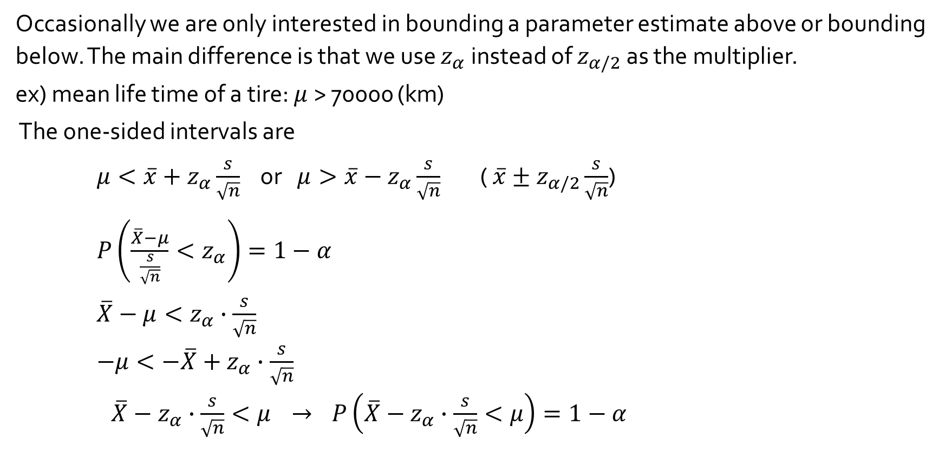
One-sided intervals
Occasionally we are only interested in bounding a parameter estimate above or bounding below. The main difference is that we use $z_{α}$instead of $z_{α/2}$ as the multiplier.
ex) mean life time of a tire: $μ$> 70000 (km)
The one-sided intervals are
${μ<\overline{x}+z}_{α}\frac{s}{\sqrt{n}}$ or ${μ>\overline{x}−z}_{α}\frac{s}{\sqrt{n}}$ ( $\overline{x}±z_{α/2}\frac{s}{\sqrt{n}}$)
$P\left(\frac{\overline{X}−μ}{\frac{s}{\sqrt{n}}}<z_{α}\right)=1−α$
$\overline{X}−μ<z_{α}∙\frac{s}{\sqrt{n}}$
$−μ<−\overline{X}+z_{α}∙\frac{s}{\sqrt{n}}$
$\overline{X}−z_{α}∙\frac{s}{\sqrt{n}}<μ$ $→$ $P\left(\overline{X}−z_{α}∙\frac{s}{\sqrt{n}}<μ\right)=1−α$

Slide 2
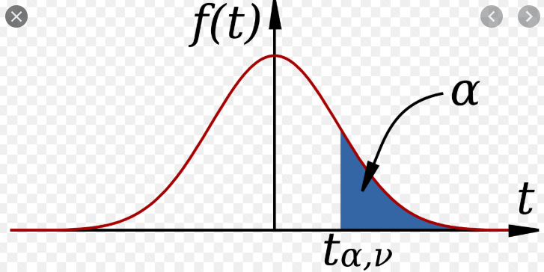
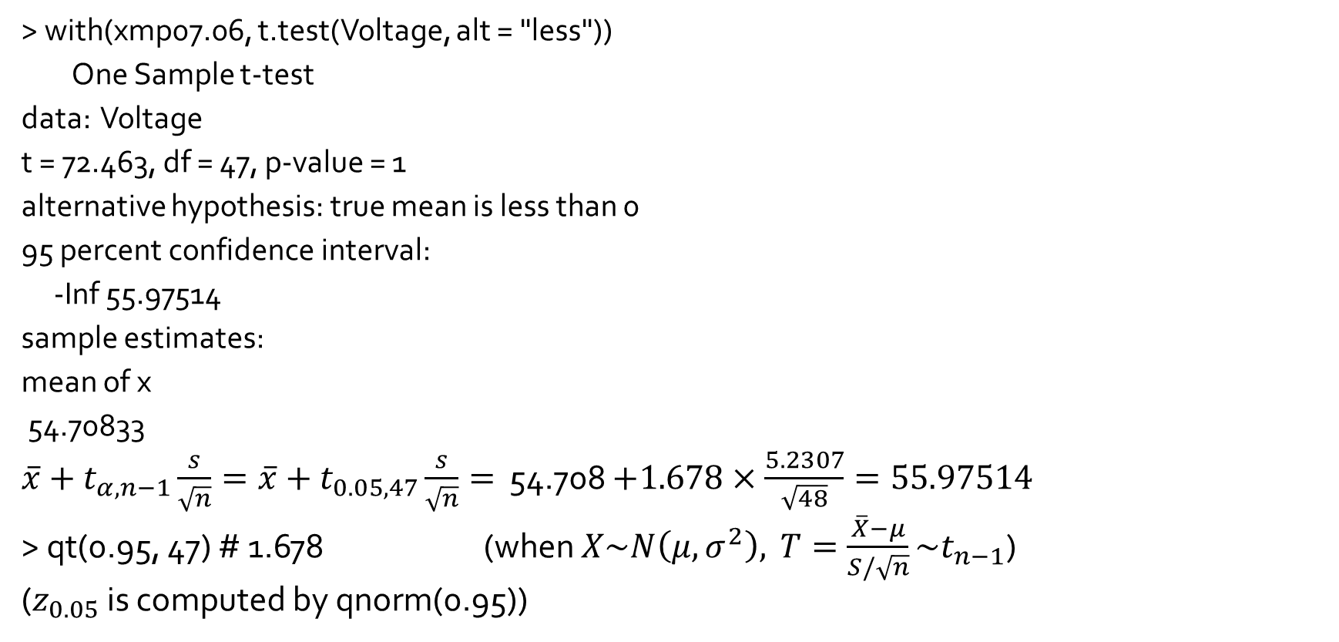
One-sided intervals
> with(xmp07.06, t.test(Voltage, alt = "less"))
One Sample t-test
data: Voltage
t = 72.463, df = 47, p-value = 1
alternative hypothesis: true mean is less than 0
95 percent confidence interval:
-Inf 55.97514
sample estimates:
mean of x
54.70833
$\overline{x}+t_{α,n−1}\frac{s}{\sqrt{n}}=\overline{x}+t_{0.05, 47}\frac{s}{\sqrt{n}}=$ 54.708 $+1.678×\frac{5.2307}{\sqrt{48}}=55.97514$
> qt(0.95, 47) # 1.678 (when $X\sim N\left(μ, σ^{2}\right),$ $T=\frac{\overline{X}−μ}{S/\sqrt{n}}\sim t_{n−1}$)
($z_{0.05}$ is computed by qnorm(0.95))

Slide 3
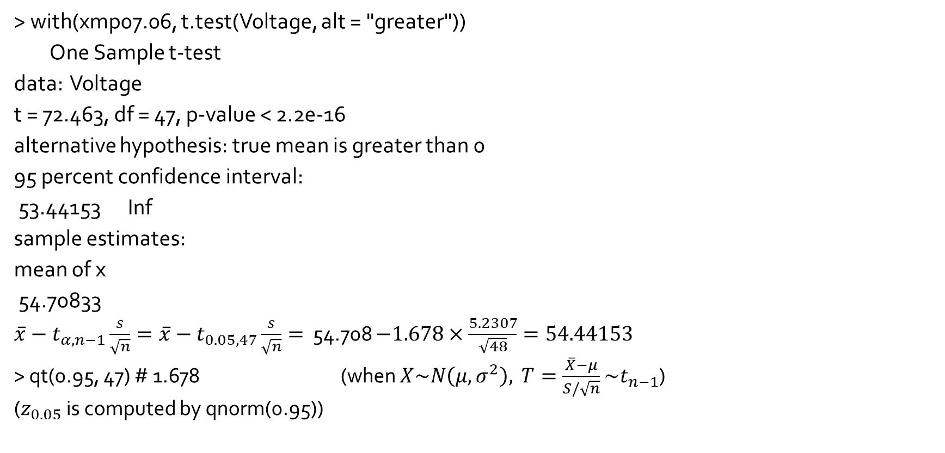
One-sided intervals
> with(xmp07.06, t.test(Voltage, alt = "greater"))
One Sample t-test
data: Voltage
t = 72.463, df = 47, p-value < 2.2e-16
alternative hypothesis: true mean is greater than 0
95 percent confidence interval:
53.44153 Inf
sample estimates:
mean of x
54.70833
$\overline{x}−t_{α,n−1}\frac{s}{\sqrt{n}}=\overline{x}−t_{0.05, 47}\frac{s}{\sqrt{n}}=$ 54.708 $−1.678×\frac{5.2307}{\sqrt{48}}=54.44153$
> qt(0.95, 47) # 1.678 (when $X\sim N\left(μ, σ^{2}\right),$ $T=\frac{\overline{X}−μ}{S/\sqrt{n}}\sim t_{n−1}$)
($z_{0.05}$ is computed by qnorm(0.95))

